Slide 1
DSA – L5
(CS C 363 / IS C 363)

Slide 2
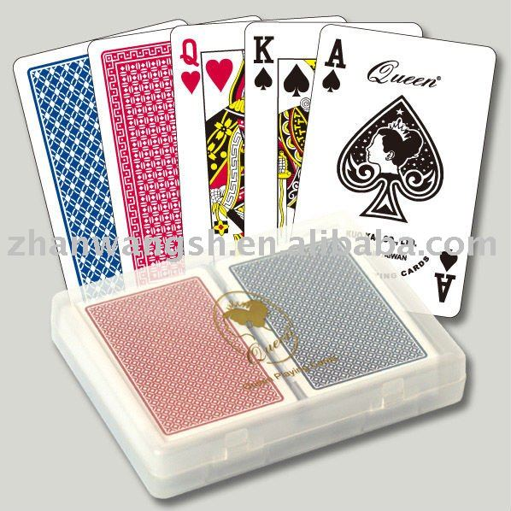
Insertion Sort

Slide 3
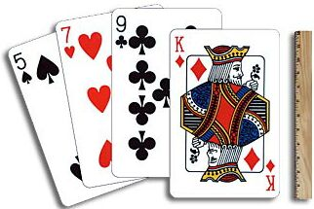
Insertion Sort

Slide 4
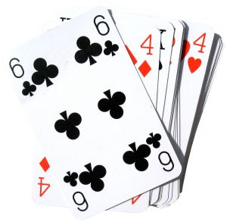
Insertion Sort

Slide 5

Insertion Sort
Sorting problem:
  Given an array of N integers, rearrange them so that they are in increasing order.
Insertion sort
  Brute-force sorting solution.
  Move left-to-right through array.
  Exchange next element with larger elements to its left, one-by-one.

Slide 6
Insertion Sort Demo
Sorting problem:
  Given an array of N integers, rearrange them so that they are in increasing order.
Insertion sort
  Brute-force sorting solution.
  Move left-to-right through array.
  Exchange next element with larger elements to its left, one-by-one.

Slide 7
Insertion Sort Demo
Sorting problem:
  Given an array of N integers, rearrange them so that they are in increasing order.
Insertion sort
  Brute-force sorting solution.
  Move left-to-right through array.
  Exchange next element with larger elements to its left, one-by-one.

Slide 8
Insertion Sort Demo
Sorting problem:
  Given an array of N integers, rearrange them so that they are in increasing order.
Insertion sort
  Brute-force sorting solution.
  Move left-to-right through array.
  Exchange next element with larger elements to its left, one-by-one.

Slide 9
Insertion Sort Demo
Sorting problem:
  Given an array of N integers, rearrange them so that they are in increasing order.
Insertion sort
  Brute-force sorting solution.
  Move left-to-right through array.
  Exchange next element with larger elements to its left, one-by-one.

Slide 10
Insertion Sort Demo
Sorting problem:
  Given an array of N integers, rearrange them so that they are in increasing order.
Insertion sort
  Brute-force sorting solution.
  Move left-to-right through array.
  Exchange next element with larger elements to its left, one-by-one.

Slide 11
Insertion Sort Demo
Sorting problem:
  Given an array of N integers, rearrange them so that they are in increasing order.
Insertion sort
  Brute-force sorting solution.
  Move left-to-right through array.
  Exchange next element with larger elements to its left, one-by-one.

Slide 12
Insertion Sort Demo
Sorting problem:
  Given an array of N integers, rearrange them so that they are in increasing order.
Insertion sort
  Brute-force sorting solution.
  Move left-to-right through array.
  Exchange next element with larger elements to its left, one-by-one.

Slide 13
Insertion Sort Demo
Sorting problem:
  Given an array of N integers, rearrange them so that they are in increasing order.
Insertion sort
  Brute-force sorting solution.
  Move left-to-right through array.
  Exchange next element with larger elements to its left, one-by-one.

Slide 14
Insertion Sort Demo
Sorting problem:
  Given an array of N integers, rearrange them so that they are in increasing order.
Insertion sort
  Brute-force sorting solution.
  Move left-to-right through array.
  Exchange next element with larger elements to its left, one-by-one.

Slide 15
Insertion Sort Demo
Sorting problem:
  Given an array of N integers, rearrange them so that they are in increasing order.
Insertion sort
  Brute-force sorting solution.
  Move left-to-right through array.
  Exchange next element with larger elements to its left, one-by-one.

Slide 16
Insertion Sort Demo
Sorting problem:
  Given an array of N integers, rearrange them so that they are in increasing order.
Insertion sort
  Brute-force sorting solution.
  Move left-to-right through array.
  Exchange next element with larger elements to its left, one-by-one.

Slide 17
Insertion Sort Demo
Sorting problem:
  Given an array of N integers, rearrange them so that they are in increasing order.
Insertion sort
  Brute-force sorting solution.
  Move left-to-right through array.
  Exchange next element with larger elements to its left, one-by-one.

Slide 18
Insertion Sort Demo
Sorting problem:
  Given an array of N integers, rearrange them so that they are in increasing order.
Insertion sort
  Brute-force sorting solution.
  Move left-to-right through array.
  Exchange next element with larger elements to its left, one-by-one.

Slide 19
Insertion Sort Demo
Sorting problem:
  Given an array of N integers, rearrange them so that they are in increasing order.
Insertion sort
  Brute-force sorting solution.
  Move left-to-right through array.
  Exchange next element with larger elements to its left, one-by-one.

Slide 20
Insertion Sort Demo
Sorting problem:
  Given an array of N integers, rearrange them so that they are in increasing order.
Insertion sort
  Brute-force sorting solution.
  Move left-to-right through array.
  Exchange next element with larger elements to its left, one-by-one.

Slide 21
Insertion Sort Demo
Sorting problem:
  Given an array of N integers, rearrange them so that they are in increasing order.
Insertion sort
  Brute-force sorting solution.
  Move left-to-right through array.
  Exchange next element with larger elements to its left, one-by-one.

Slide 22
Insertion Sort Demo
Sorting problem:
  Given an array of N integers, rearrange them so that they are in increasing order.
Insertion sort
  Brute-force sorting solution.
  Move left-to-right through array.
  Exchange next element with larger elements to its left, one-by-one.

Slide 23
Insertion Sort Demo
Sorting problem:
  Given an array of N integers, rearrange them so that they are in increasing order.
Insertion sort
  Brute-force sorting solution.
  Move left-to-right through array.
  Exchange next element with larger elements to its left, one-by-one.

Slide 24
Insertion Sort Demo
Sorting problem:
  Given an array of N integers, rearrange them so that they are in increasing order.
Insertion sort
  Brute-force sorting solution.
  Move left-to-right through array.
  Exchange next element with larger elements to its left, one-by-one.

Slide 25
Insertion Sort Demo
Sorting problem:
  Given an array of N integers, rearrange them so that they are in increasing order.
Insertion sort
  Brute-force sorting solution.
  Move left-to-right through array.
  Exchange next element with larger elements to its left, one-by-one.

Slide 26
Insertion Sort Demo
Sorting problem:
  Given an array of N integers, rearrange them so that they are in increasing order.
Insertion sort
  Brute-force sorting solution.
  Move left-to-right through array.
  Exchange next element with larger elements to its left, one-by-one.

Slide 27
Insertion Sort Demo
Sorting problem:
  Given an array of N integers, rearrange them so that they are in increasing order.
Insertion sort
  Brute-force sorting solution.
  Move left-to-right through array.
  Exchange next element with larger elements to its left, one-by-one.

Slide 28
Insertion Sort Demo
Sorting problem:
  Given an array of N integers, rearrange them so that they are in increasing order.
Insertion sort
  Brute-force sorting solution.
  Move left-to-right through array.
  Exchange next element with larger elements to its left, one-by-one.

Slide 29
Insertion Sort Demo
Sorting problem:
  Given an array of N integers, rearrange them so that they are in increasing order.
Insertion sort
  Brute-force sorting solution.
  Move left-to-right through array.
  Exchange next element with larger elements to its left, one-by-one.

Slide 30
Insertion Sort Demo
Sorting problem:
  Given an array of N integers, rearrange them so that they are in increasing order.
Insertion sort
  Brute-force sorting solution.
  Move left-to-right through array.
  Exchange next element with larger elements to its left, one-by-one.

Slide 31
Insertion Sort Demo
Sorting problem:
  Given an array of N integers, rearrange them so that they are in increasing order.
Insertion sort
  Brute-force sorting solution.
  Move left-to-right through array.
  Exchange next element with larger elements to its left, one-by-one.

Slide 32
Insertion Sort Demo
Sorting problem:
  Given an array of N integers, rearrange them so that they are in increasing order.
Insertion sort
  Brute-force sorting solution.
  Move left-to-right through array.
  Exchange next element with larger elements to its left, one-by-one.

Slide 33
Insertion Sort Demo
Sorting problem:
  Given an array of N integers, rearrange them so that they are in increasing order.
Insertion sort
  Brute-force sorting solution.
  Move left-to-right through array.
  Exchange next element with larger elements to its left, one-by-one.

Slide 34
Insertion Sort Demo
Sorting problem:
  Given an array of N integers, rearrange them so that they are in increasing order.
Insertion sort
  Brute-force sorting solution.
  Move left-to-right through array.
  Exchange next element with larger elements to its left, one-by-one.

Slide 35
Insertion Sort Demo
Sorting problem:
  Given an array of N integers, rearrange them so that they are in increasing order.
Insertion sort
  Brute-force sorting solution.
  Move left-to-right through array.
  Exchange next element with larger elements to its left, one-by-one.

Slide 36
Insertion Sort Demo
Sorting problem:
  Given an array of N integers, rearrange them so that they are in increasing order.
Insertion sort
  Brute-force sorting solution.
  Move left-to-right through array.
  Exchange next element with larger elements to its left, one-by-one.

Slide 37
Insertion Sort Demo
Sorting problem:
  Given an array of N integers, rearrange them so that they are in increasing order.
Insertion sort
  Brute-force sorting solution.
  Move left-to-right through array.
  Exchange next element with larger elements to its left, one-by-one.

Slide 38
Insertion Sort Demo
Sorting problem:
  Given an array of N integers, rearrange them so that they are in increasing order.
Insertion sort
  Brute-force sorting solution.
  Move left-to-right through array.
  Exchange next element with larger elements to its left, one-by-one.

Slide 39
Insertion Sort Demo
Sorting problem:
  Given an array of N integers, rearrange them so that they are in increasing order.
Insertion sort
  Brute-force sorting solution.
  Move left-to-right through array.
  Exchange next element with larger elements to its left, one-by-one.

Slide 40
Insertion Sort Demo
Sorting problem:
  Given an array of N integers, rearrange them so that they are in increasing order.
Insertion sort
  Brute-force sorting solution.
  Move left-to-right through array.
  Exchange next element with larger elements to its left, one-by-one.

Slide 41
Insertion Sort Demo
Sorting problem:
  Given an array of N integers, rearrange them so that they are in increasing order.
Insertion sort
  Brute-force sorting solution.
  Move left-to-right through array.
  Exchange next element with larger elements to its left, one-by-one.

Slide 42
Insertion Sort Demo
Sorting problem:
  Given an array of N integers, rearrange them so that they are in increasing order.
Insertion sort
  Brute-force sorting solution.
  Move left-to-right through array.
  Exchange next element with larger elements to its left, one-by-one.

Slide 43
Insertion Sort Demo
Sorting problem:
  Given an array of N integers, rearrange them so that they are in increasing order.
Insertion sort
  Brute-force sorting solution.
  Move left-to-right through array.
  Exchange next element with larger elements to its left, one-by-one.

Slide 44
Insertion Sort Demo
Sorting problem:
  Given an array of N integers, rearrange them so that they are in increasing order.
Insertion sort
  Brute-force sorting solution.
  Move left-to-right through array.
  Exchange next element with larger elements to its left, one-by-one.

Slide 45
Insertion Sort Demo
Sorting problem:
  Given an array of N integers, rearrange them so that they are in increasing order.
Insertion sort
  Brute-force sorting solution.
  Move left-to-right through array.
  Exchange next element with larger elements to its left, one-by-one.

Slide 46
Insertion Sort Demo
Sorting problem:
  Given an array of N integers, rearrange them so that they are in increasing order.
Insertion sort
  Brute-force sorting solution.
  Move left-to-right through array.
  Exchange next element with larger elements to its left, one-by-one.

Slide 47
Insertion Sort Demo
Sorting problem:
  Given an array of N integers, rearrange them so that they are in increasing order.
Insertion sort
  Brute-force sorting solution.
  Move left-to-right through array.
  Exchange next element with larger elements to its left, one-by-one.

Slide 48
Insertion Sort Demo
Sorting problem:
  Given an array of N integers, rearrange them so that they are in increasing order.
Insertion sort
  Brute-force sorting solution.
  Move left-to-right through array.
  Exchange next element with larger elements to its left, one-by-one.

Slide 49
Insertion Sort Demo
Sorting problem:
  Given an array of N integers, rearrange them so that they are in increasing order.
Insertion sort
  Brute-force sorting solution.
  Move left-to-right through array.
  Exchange next element with larger elements to its left, one-by-one.

